Slide 1
K- Nearst Neighbors (KNN)
Dr. Gede Angga Pradipta S.T.,M.Eng

Slide 2
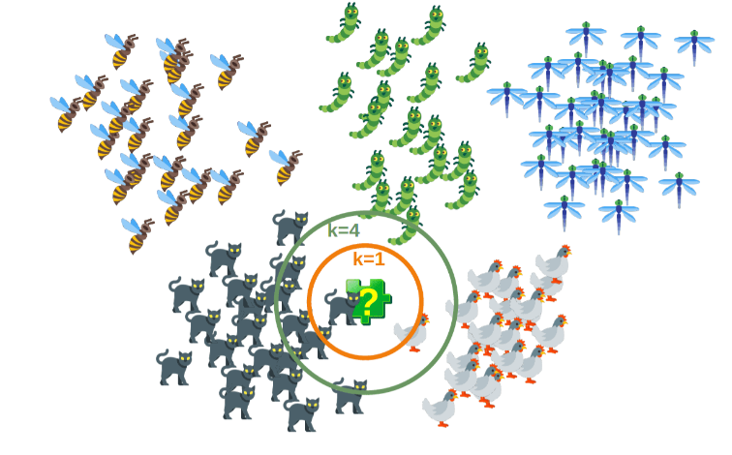
Introduction
K-nearest neighbors (KNN) is a type of supervised learning algorithm used for both regression and classification. KNN tries to predict the correct class for the test data by calculating the distance between the test data and all the training points. Then select the K number of points which is closet to the test data. The KNN algorithm calculates the probability of the test data belonging to the classes of ‘K’ training data and class holds the highest probability will be selected. In the case of regression, the value is the mean of the ‘K’ selected training points.

Slide 3
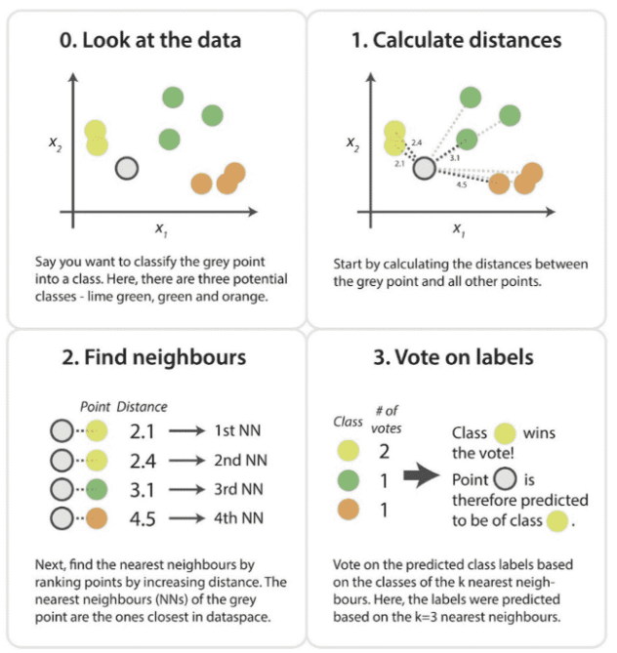

Slide 4
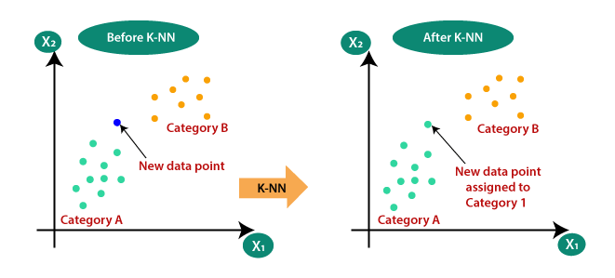
Why do we need a K-NN Algorithm?
Suppose there are two categories, i.e., Category A and Category B, and we have a new data point x1, so this data point will lie in which of these categories. To solve this type of problem, we need a K-NN algorithm. With the help of K-NN, we can easily identify the category or class of a particular dataset. Consider the below diagram:

Slide 5
How does K-NN work?
The K-NN working can be explained on the basis of the below algorithm:
Step-1: Select the number K of the neighbors
Step-2: Calculate the Euclidean distance of K number of neighbors
Step-3: Take the K nearest neighbors as per the calculated Euclidean distance.
Step-4: Among these k neighbors, count the number of the data points in each category.
Step-5: Assign the new data points to that category for which the number of the neighbor is maximum.
Step-6: Our model is ready.

Slide 6
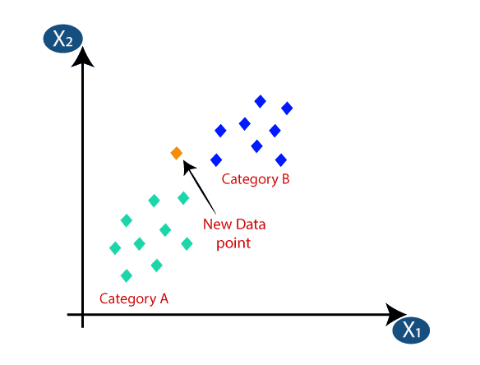
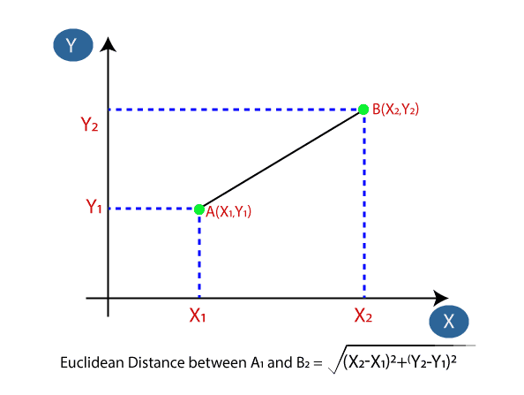
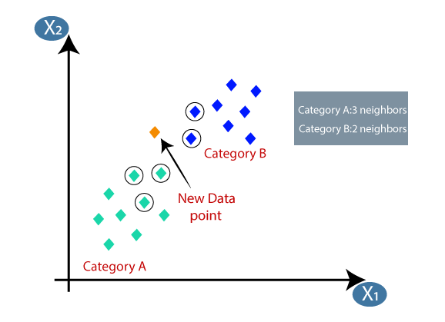
Euclidean distance
Firstly, we will choose the number of neighbors, so we will choose the k=5.
Next, we will calculate the Euclidean distance between the data points. The Euclidean distance is the distance between two points, which we have already studied in geometry. It can be calculated as:
By calculating the Euclidean distance we got the nearest neighbors, as three nearest neighbors in category A and two nearest neighbors in category B. Consider the below image:
As we can see the 3 nearest neighbors are from category A, hence this new data point must belong to category A.

Slide 7
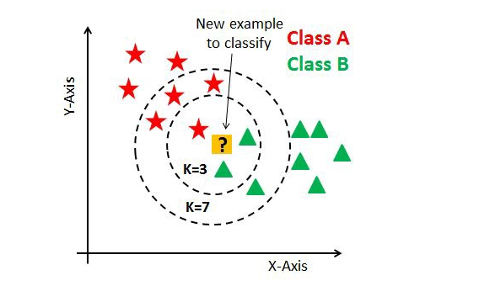
How to choose a K value?
Kvalue indicates the count of the nearest neighbors. We have to compute distances between test points and trained labels points. Updating distance metrics with every iteration is computationally expensive, and that’s why KNN is a lazy learning algorithm.
As you can verify from the above image, if we proceed with K=3, then we predict that test input belongs to class B, and if we continue with K=7, then we predict that test input belongs to class A.
That’s how you can imagine that the K value has a powerful effect on KNN performance.

Slide 8
Then how to select the optimal K value?
There are no pre-defined statistical methods to find the most favorable value of K.
Initialize a random K value and start computing.
Choosing a small value of K leads to unstable decision boundaries.
The substantial K value is better for classification as it leads to smoothening the decision boundaries.
Derive a plot between error rate and K denoting values in a defined range. Then choose the K value as having a minimum error rate.

